Slide 1
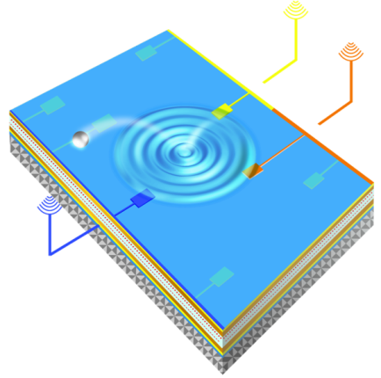
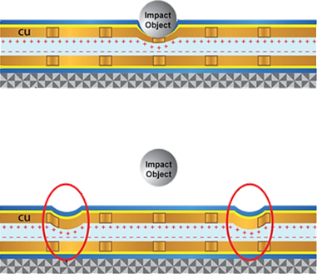
Passive Tactile Sensing UCLA Masters of Engineering Design Study
Eric K. Sender Professor Christopher S. Lynch UCLA Masters of Engineering - Spring 2012

Slide 2
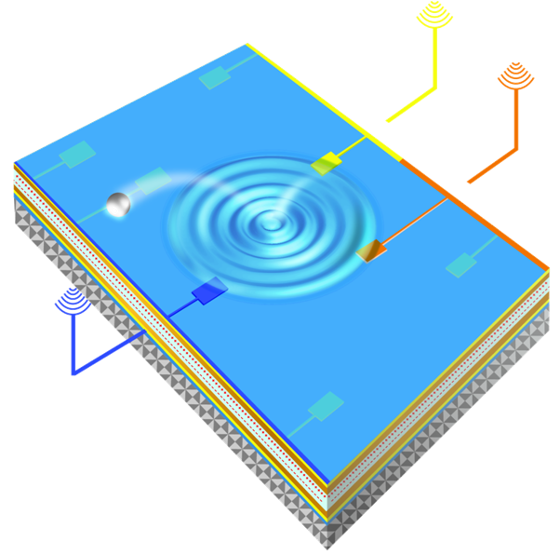
Project Overview
The proposed design is a passive, wireless tactile sensor
By using the piezoelectric effect and a carefully arranged set of parallel plate capacitors, radio-frequency chirps can be observed after an impact occurs on the sensor
The received chirps can be triangulated to give an accurate location of impact

Slide 3
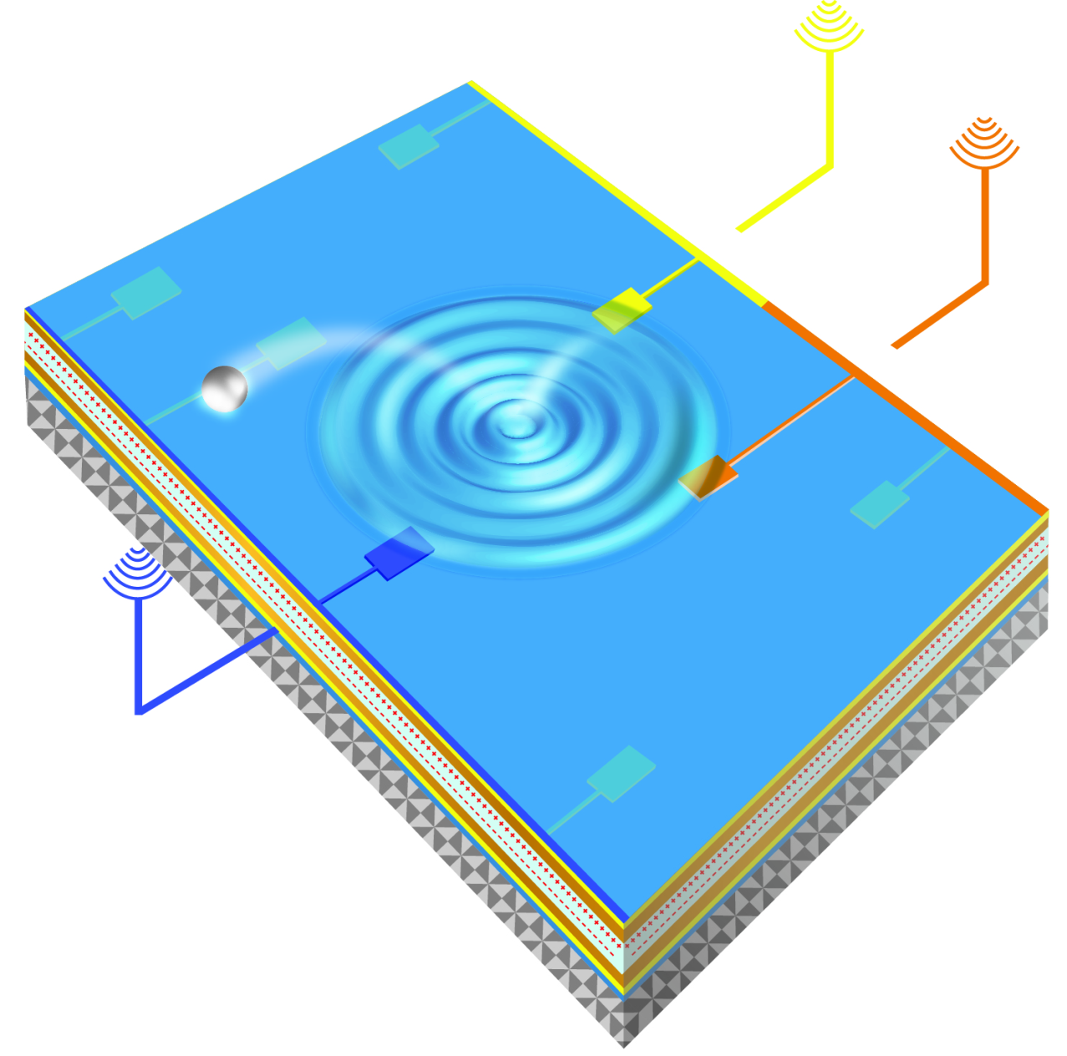
Action View
An object hits the sensor
SAW is produced
Crest of SAW activates nodes via Piezoelectric effect
Nodes produce wireless chirp
Location is resolved with Triangulation

Slide 4
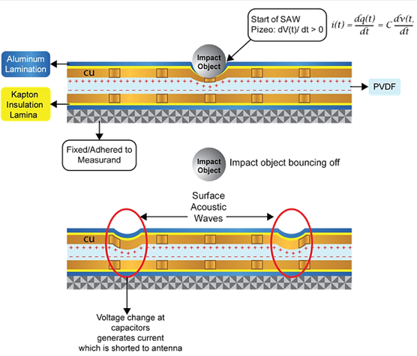
Design Side View

Slide 5
Material Overview
Referring to the previous slide, “Design Side View” the proposed set of materials, in order, for this impact sensor are:
Aluminum top Layer
Kapton top Layer
Copper top Layer
Piezoelectric Polymer (PVDF) middle dielectric Layer
Copper bottom Layer
Kapton bottom Layer
Aluminum bottom Layer

Slide 6
Functional Overview
The sensor is to function as such:
Shape wise, it will be rectangular and extremely thin. Each layer will be on the order of a mil (thousandth of an inch)
The sensor will be adhered to a surface, such as an aerospace payload, where it will be exposed to the elements
As objects impact the sensor, a natural surface acoustic wave (SAW) will occur
This SAW, as it traverses across the piezoelectric polymer layer, will produce an electric field.
These charges will create current on the copper islands which will drain into an antenna attached to the sensor
The antenna will emit chirps whose center frequencies are related to the unique shapes of the capacitive island

Slide 7
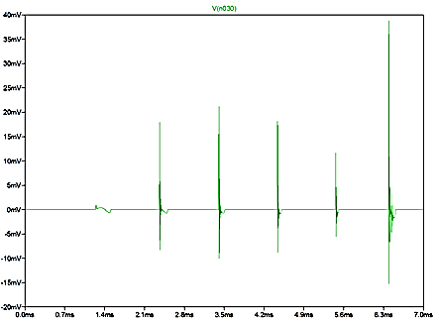
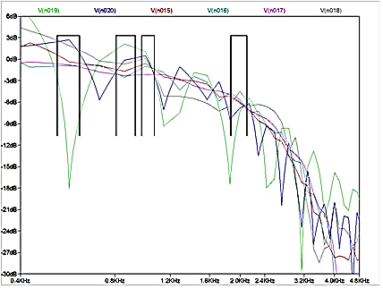
Chirp Representation
Left figure shows a time domain view of the chirps emitting from the sensor
Right figure shows a frequency transform of these chirps – uses FFT

Slide 8
Systems Overview
A middleware receiver will be set to pick up these chirps and mark the time difference of arrival (TDOA) of each chirp.
With proper software, the TDOA can be used to triangulate the location of impact using a two dimensional multilateration algorithm.
This algorithm is based on the intersection of 3 circles
In initial testing, the algorithm is quite fast in Matlab and will be discussed later in the presentation.
This report will constitute the design study of the sensor itself, as well as the triangulation algorithm.
The study of the antenna, radio frequency specification, and middleware system will be done by a fellow UCLA Masters of engineering student in a separate report.

Slide 9
Report Goals
The goal of this masters project is to study each material used, study the piezoelectric effect, study the expected voltages that could be produced, and study the algorithm which will union them all.
I plan to utilize many resources from journals, books, and internet
I plan to create a finite element model based on the most important assumptions of this project
The overall goal is to build the ground work for creating a prototype in a laboratory

Slide 10
Aluminum Purpose
The aluminum is set to act as a protective shield to the sensor.
Since the sensor is exposed to the elements, a protective layer will be necessary.
Damage potential will be reduced
The aluminum layer may be able to act as a crude antenna if other antenna designs prove too cumbersome

Slide 11
Kapton Purpose
Kapton is a well regarded insulator and will electrically separate the capacitive layer
This will be described in the proceeding slides
Kapton may be used within the copper layers as well to reduce potential parasitic effects.
Again, this will be explained further in the capacitor and conductor slides.

Slide 12
Copper & Capacitor Layer
Copper is one of the best conductors and is relatively low cost, thus it will serve as the top and bottom plates of the capacitors.
Referring to Design Side View, the copper will be split into an array of islands.
Each island will vary slightly geometrically, thus constituting a different capacitive value.
Since transient current is a function of capacitance, this will inherently allow for unique chirps from each island.
I.e., these different capacitive values will cause frequency shifts in the RF output
Thus allowing a detector to distinguish one capacitor from another, and hence one location from another.

Slide 13
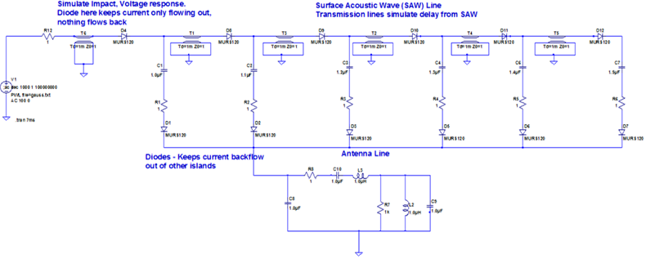
Electrical Loads/SPICE
SPICE is used to create a purely electrical simulation of the sensor in action.
Transmission lines create the delay effect, diodes ensure directionality in the current flow, and the RC-branches model the sensor’s capacitive nodes.

Slide 14
Chirp Representation
Same figures as slide 7

Slide 15
Parasitic Effects
Parasitic effects could be present if unintended conducting lines and capacitors become present.
In the copper layer, it may be advantageous to strip all unneeded copper from the sensor and, to fill the vacancy, replace it with more Kapton.
Thus the copper will only form islands and conducting lines. No floating copper.
Current may also leak to other nodes; to resolve this, implanting polymer based diodes at each capacitive island will electrically isolate each island.

Slide 16
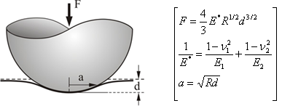
Contact Mechanics
A study of the physical impact is conducted
The physical impact duration is closely related to the frequency range of the sensor.
The quicker the actual impact takes place, the more frequency is produced
This will be looked at more in the Piezoelectric Effect slides
Based on Hertzian Contact Solution

Slide 17
Contact Mechanics
Multiple perspectives to study impact duration:
1 – Velocity and material factor
2 – Resonant frequency factor
3 – Observational perspective
Analyze many impacts with a high speed camera and generate statistics
Each method produces an impact duration on the order of 100 microseconds

Slide 18
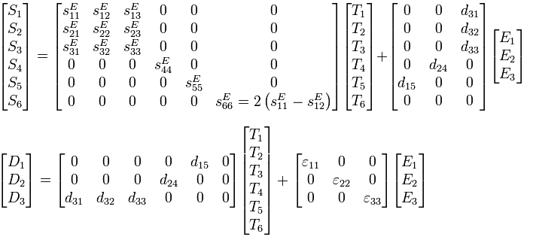
Piezoelectric Effect
The Piezoelectric Effect is mathematically modeled by a large coupling matrix equation which relates a material’s Young’s modulus, Permittivity, Piezoelectric coefficients, and input Stress.
The following equation relates normal stress with voltage:

Slide 19
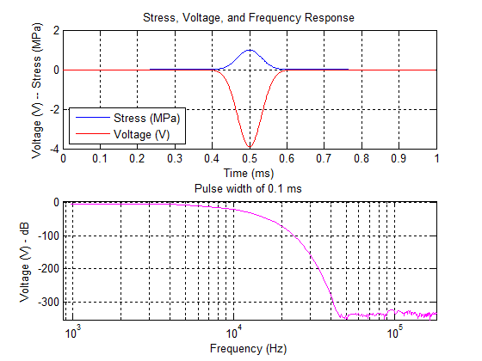
Piezoelectric Effect – Frequency Response
The following input stress is applied:
1 MPa Gaussian
0.1 ms pulse width
Onto a 1 mil thick PVDF
This shows a useable bandwidth in the sub 2 kHz range

Slide 20
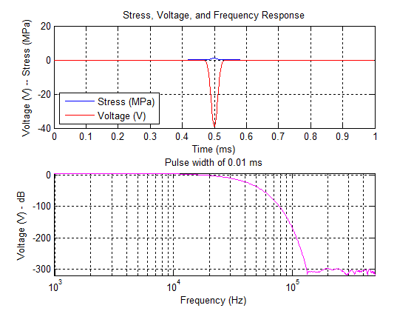
Piezoelectric Effect – Frequency Response
The following input stress is applied:
1 MPa Gaussian
0.01 ms pulse width
Onto a 10 mil thick PVDF
This shows a useable bandwidth in the sub 10 kHz range

Slide 21
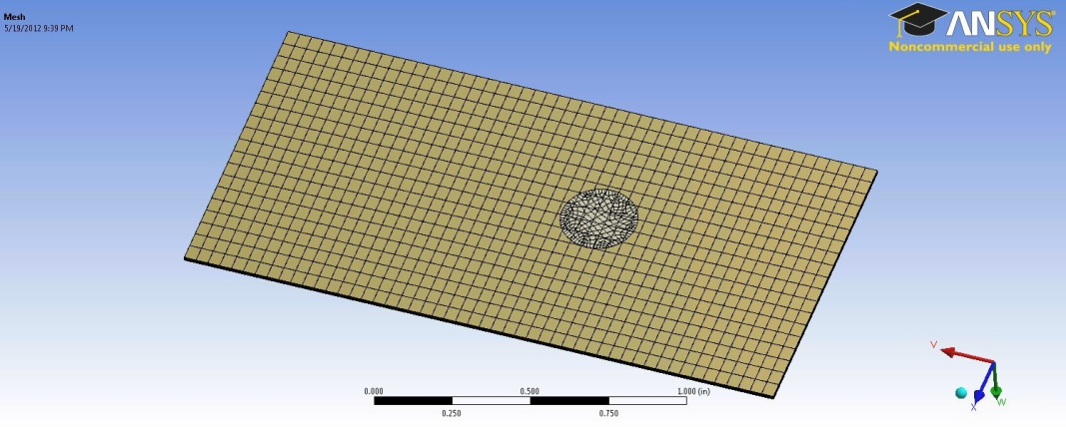
Finite Element Analysis
This figure shows the Finite Element Analysis (FEA) mesh. The sensor is modeled here with 7 thin layers. The circle near the middle shows the area of impact.

Slide 22
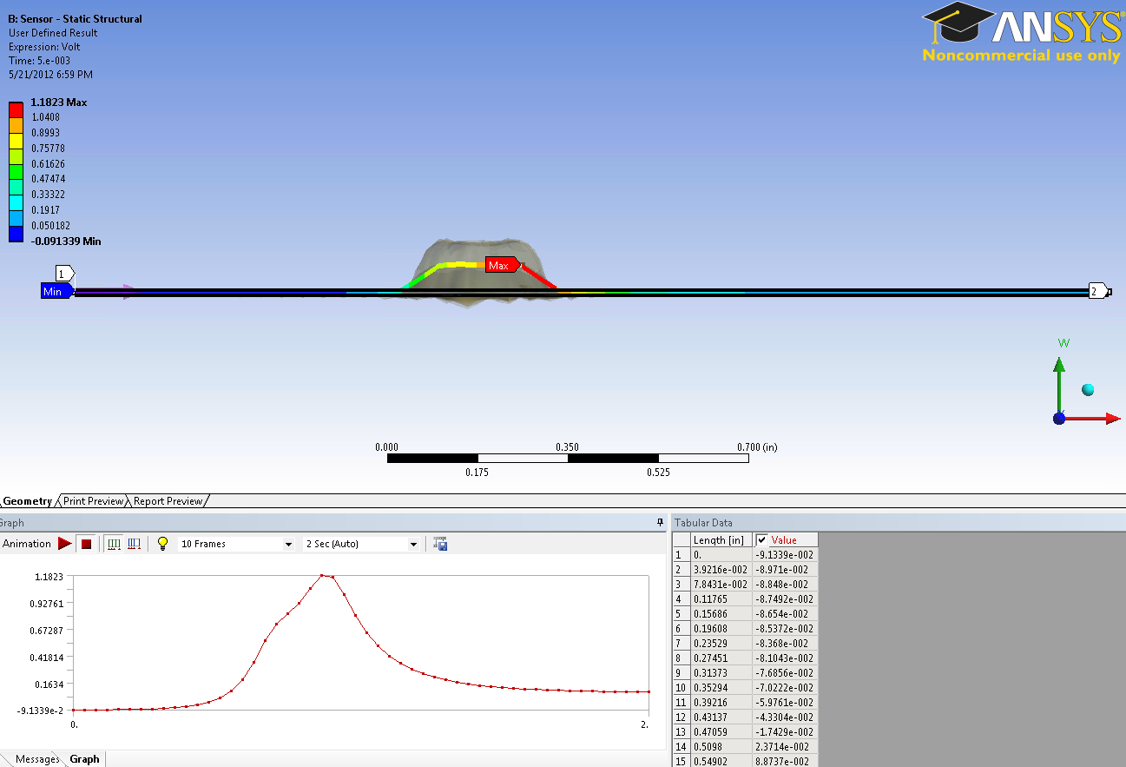
Finite Element Analysis
FEA confirms the expectation of a voltage drop on the sensor upon impact. This helps calibrate the design

Slide 23
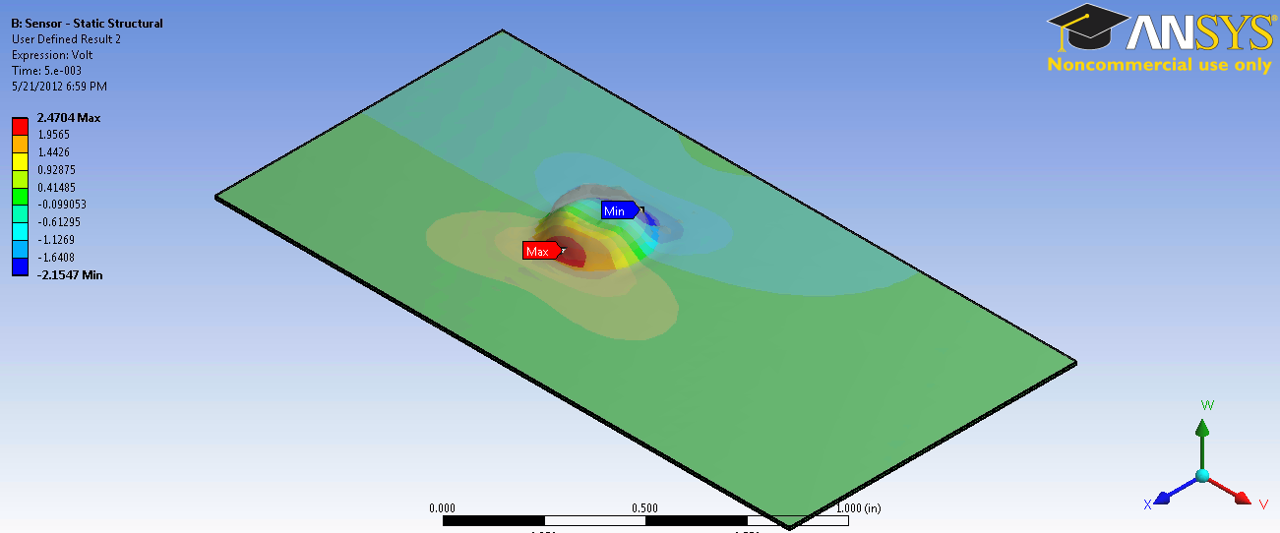
Finite Element Analysis
This analysis demonstrates a magnitude 2 voltage drop in initial wave crest

Slide 24
Triangulation Simulation
A section of this report will be devoted to simulating the triangulation algorithm in Matlab
The following will be demonstrated:
Receiving 3 signals
Finding the time difference of arrival (TDOA) of them
And knowing the origin of each signal
Constitutes all that is needed to determine the impact location

Slide 25
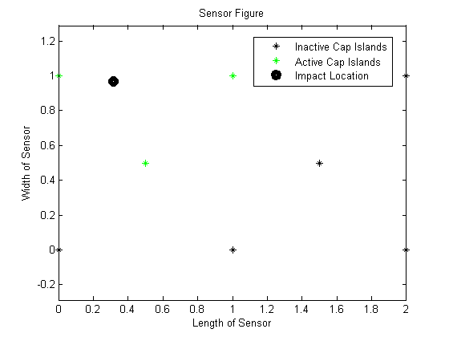
Matlab Sensor Simulator
To the left is a top view of the sensor.
The asterisks are the locations of capacitive islands (or nodes)
The impact location marked by a black dot.
Active nodes are colored green
Nodes are active (green) once the SAW touches them.
Theoretically, all nodes will activate when the SAW touches them, but only the first 3 matter for triangulation

Slide 26
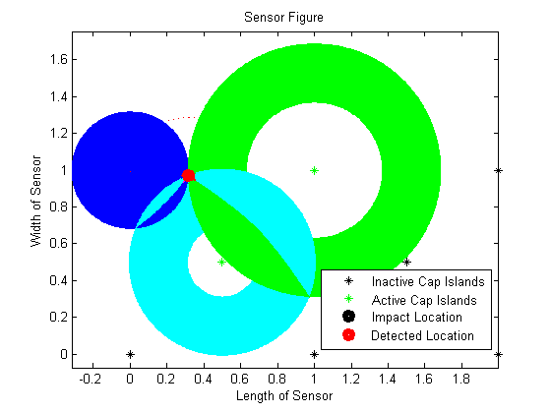
Location Resolved
This image is a visual representations of the triangulation algorithm
The resolved impact location is the red dot at the intersection of the 3 circles.
Details of this will be explained more thoroughly in the final report

Slide 27
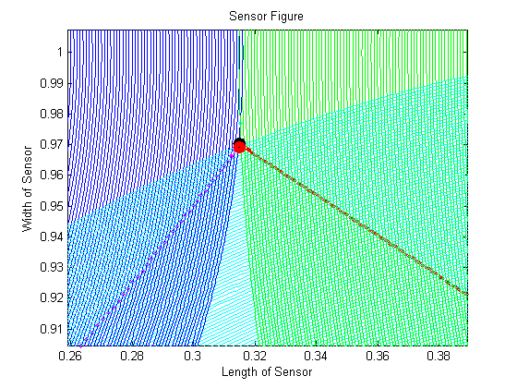
Zoomed in Location
This slide shows a close up of the detected location and impact
The delta between the actual hit and resolved location is 0.001” or 0.254 mm. Compared to its 2 sq. inch area, this is a 0.05% error.
A Monte Carlo of 30,000 simulations showed none having an error greater than 2.83%
This means that, at worst, the detected impact location will be 0.0566”, or 1.438 mm, from the actual impact location.

Slide 28
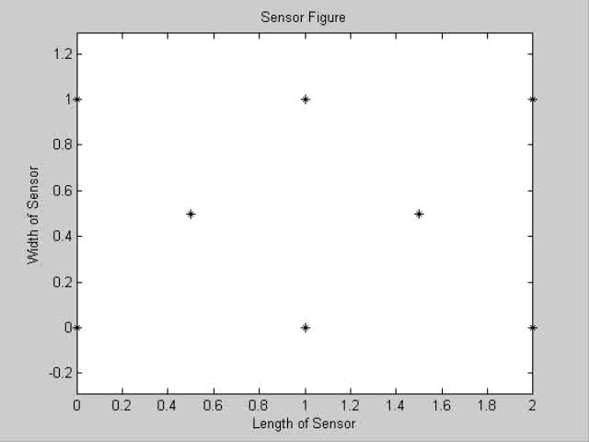
Movie: Sensor in Action

Slide 29
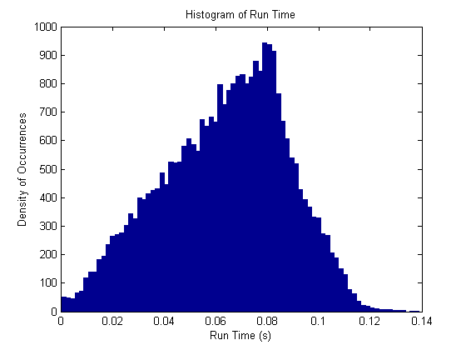
Monte Carlo Histogram – Algorithm Time
This histogram represents a set of 30,000 Monte Carlo simulations of the triangulation algorithm, reduced to 200 bins for easier viewing.
The X-axis is the amount of time it took the algorithm to determine location in seconds
Mean Sec = 0.0637
Std. Dev. = 0.0242
Max Sec = 0.3467
Min Sec = 0.0003

Slide 30
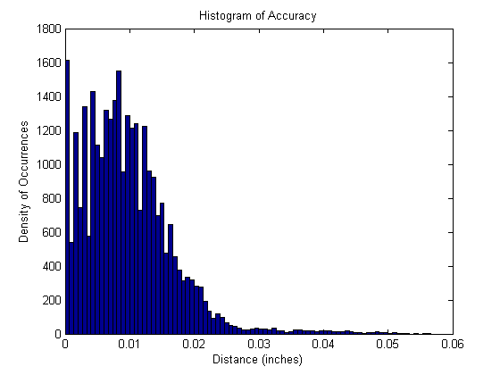
Monte Carlo Histogram – Algorithm Accuracy
This histogram aggregates the distance between the actual hit location and the algorithm’s resolved hit location.
This is based off the same 30,000 Monte Carlo and fit into 85 bins.
Of the 30,000 simulations, about 1,600 had nearly 0% error. The average error is 0.49% compared to the 2 sq. inch area.
Mean dist. = 0.0097”
Std. Dev. = 0.0070”
Max dist. = 0.0566”
Min dist. = 0.0000”

Slide 31
References
Polh, A. “A Review of Wireless SAW Sensors” Ultrasonics, Ferroelectrics and Frequency Control. IEEE Transactions on Vol. 47, PP: 317-332, 2000
Fu, Q. Luo, W. Wang, Y. Wang, J. Zhou, D. “Simulation of Wireless Passive SAW Sensors Based on FEM/BEM Model” Ultrasonics Symposium, 2008. IUS 2008 IEEE. Digital Object Identifier pp 1861 – 1864, 2008
Sherrit, S. Wiederick, H. D. Mukherjee, B. K. Sayer, M. “An accurate equivalent circuit for the unloaded piezoelectric vibrator in the thickness mode” Journal of Physics D: Applied Physics, Vol. 30, Number 16., 1997
Elvin, N. G. Elivin A. A. “A General Equivalent Circuit Model for Piezoelectric Generators” Journal of Intelligent Material System sand Structures, Vol 20, 2009
Bucher, R. Misra, D. “A Synthesizable Low Power VHDL Model of the Exact Solution of the Three Dimensional Hyperbolic Positioning System” New Jersey Center for Wireless Telecommunications, US, pp 225-228, 2002
Lee, H. Cooper, R. Wang, K. Liang, H. “Nano-Scale Characterization of Piezoelectric Polymer (Polyvinylidene Difluouride, PVDF)” Sensors 2008 ISSN 1424-8220. Pp 7359 – 7368
Takeuchi, M. Matsuzawa, S. Tairaku, K. Takatsu C. “Piezoelectric Generator as Power Supply for RFID-Tags and Applications” Ultrasonics Symposium, 2007. IEEE. PP 2558 – 2561. Year 2007.
“Interfacing PIezo Film to Electronics” Measurement Specialists Inc. www.meas-spec.com. © March 2006
Gamelin, T. W. “Complex Analysis” 1st Edition, Springer. Year 2001 ISBN-13: 978-0387950693
Collins, J. A. “Failure of Materials in Mechanical Design. Analysis, Prediction, Prevention” 2nd Edition. John Wiley & Sons. Year 1993. ISBN-13: 978-0471558910
Jones, R M. “Mechanics of Composite Materials” 2nd Edition, Virginia Polytechnic Institute and State University, PP 190 – 221. Year 1999. ISBN-13: 978-1560327127
Tillett, J. P. A. “A Study of the Impact on Spheres of Plates” Imperial Chemical Industries Limited, Butterwick Research laboratories, Welwyn, Herts. 1954

